Slide 1
Reading enums
public enum Day { SUNDAY, MONDAY, TUESDAY, WEDNESDAY, THURSDAY, FRIDAY, SATURDAY }
You could do this:
String day = "SUNDAY";
Day dayEnum = Day.valueOf(day);

Slide 2
Avoiding code duplication
Passing fields

Slide 3
The problem
I have several numeric fields that I want to find the max, min or average of.
I don’t want to duplicate code having a max method for age and another max method for grade etc

Slide 4
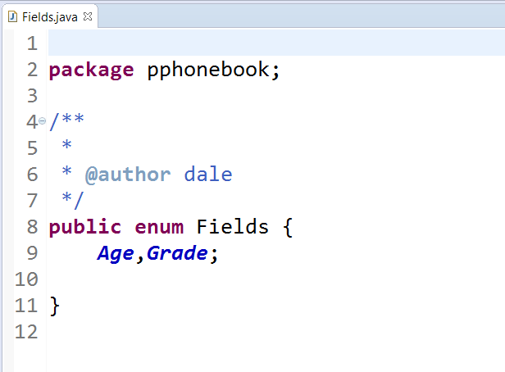
Create an enum
RC on package: New|Enum
notice it is a public enumeration in its own file
The data properties that these fields represent must be the same data type

Slide 5
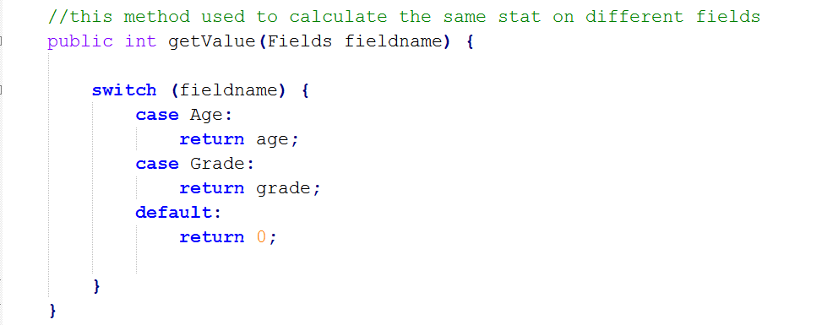
In the base class create a method

Slide 6
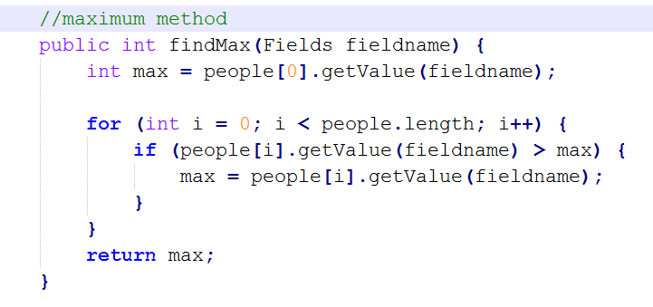
In a utilities class write the calculation method
Improve by making this a static method

Slide 7
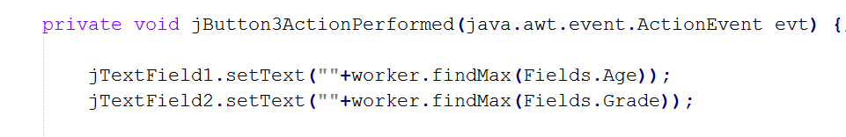
Call the method in the gui note the enum parameter passing
Or for a static method Utilities.findMax(Fields.Age)

